Slide 1
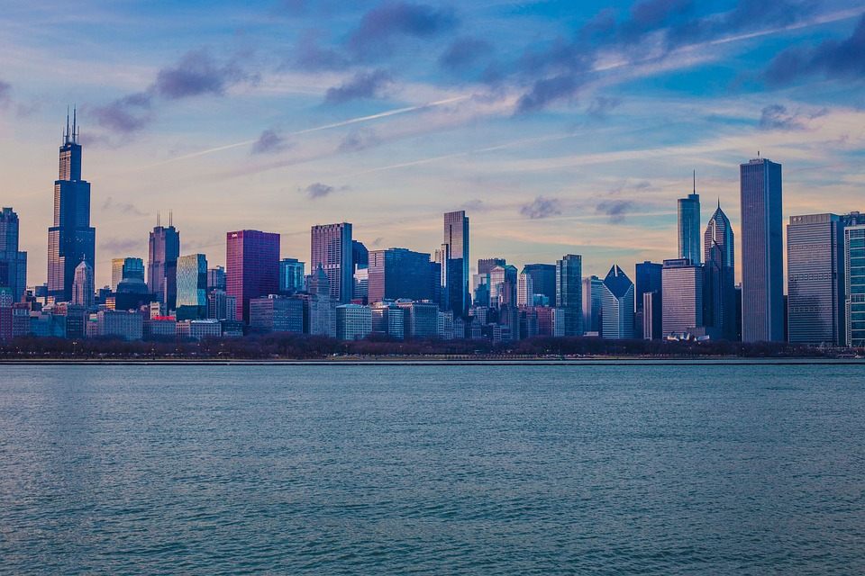
The United States of America is the world's third largest country in size and nearly the third largest in terms of population. Located in North America, the country is bordered on the west by the Pacific Ocean and to the east by the Atlantic Ocean. Along the northern border is Canada and the southern border is Mexico.

Slide 2
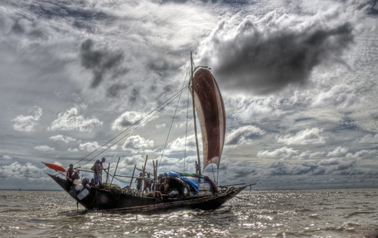
Bangladesh is a country in Southern Asia located on the Bay of Bengal, bordered by India on all sides except for a small border with Burma. Bangladesh has flat plains, and most of the country is situated on deltas of large rivers flowing from the Himalayas.

Slide 3
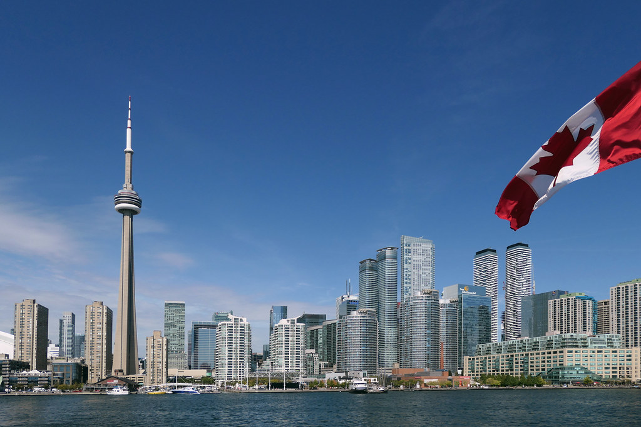
It is the second largest country in the world, but it has only one-half of one percent of the world's population. Canada features black-blue lakes, numerous rivers, majestic western mountains, rolling central plains, and forested eastern valleys.

Slide 4
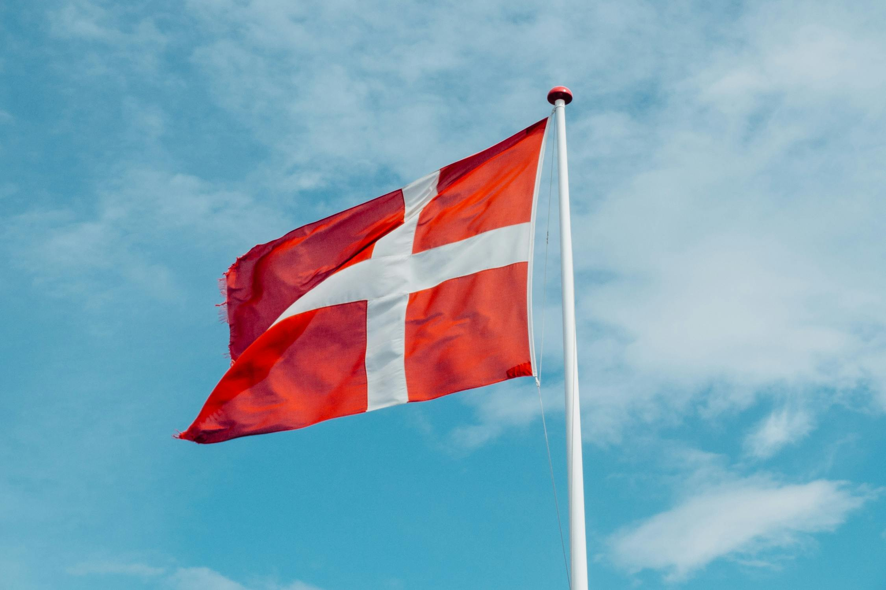
Denmark is a small country with a population of approximately 5,8 million. It is one of the three Scandinavian countries, and Denmark also shares border with Germany. You might have heard that Danes are some of the happiest people on the planet. Maybe the Danish welfare system is one of the reasons why.

Slide 5
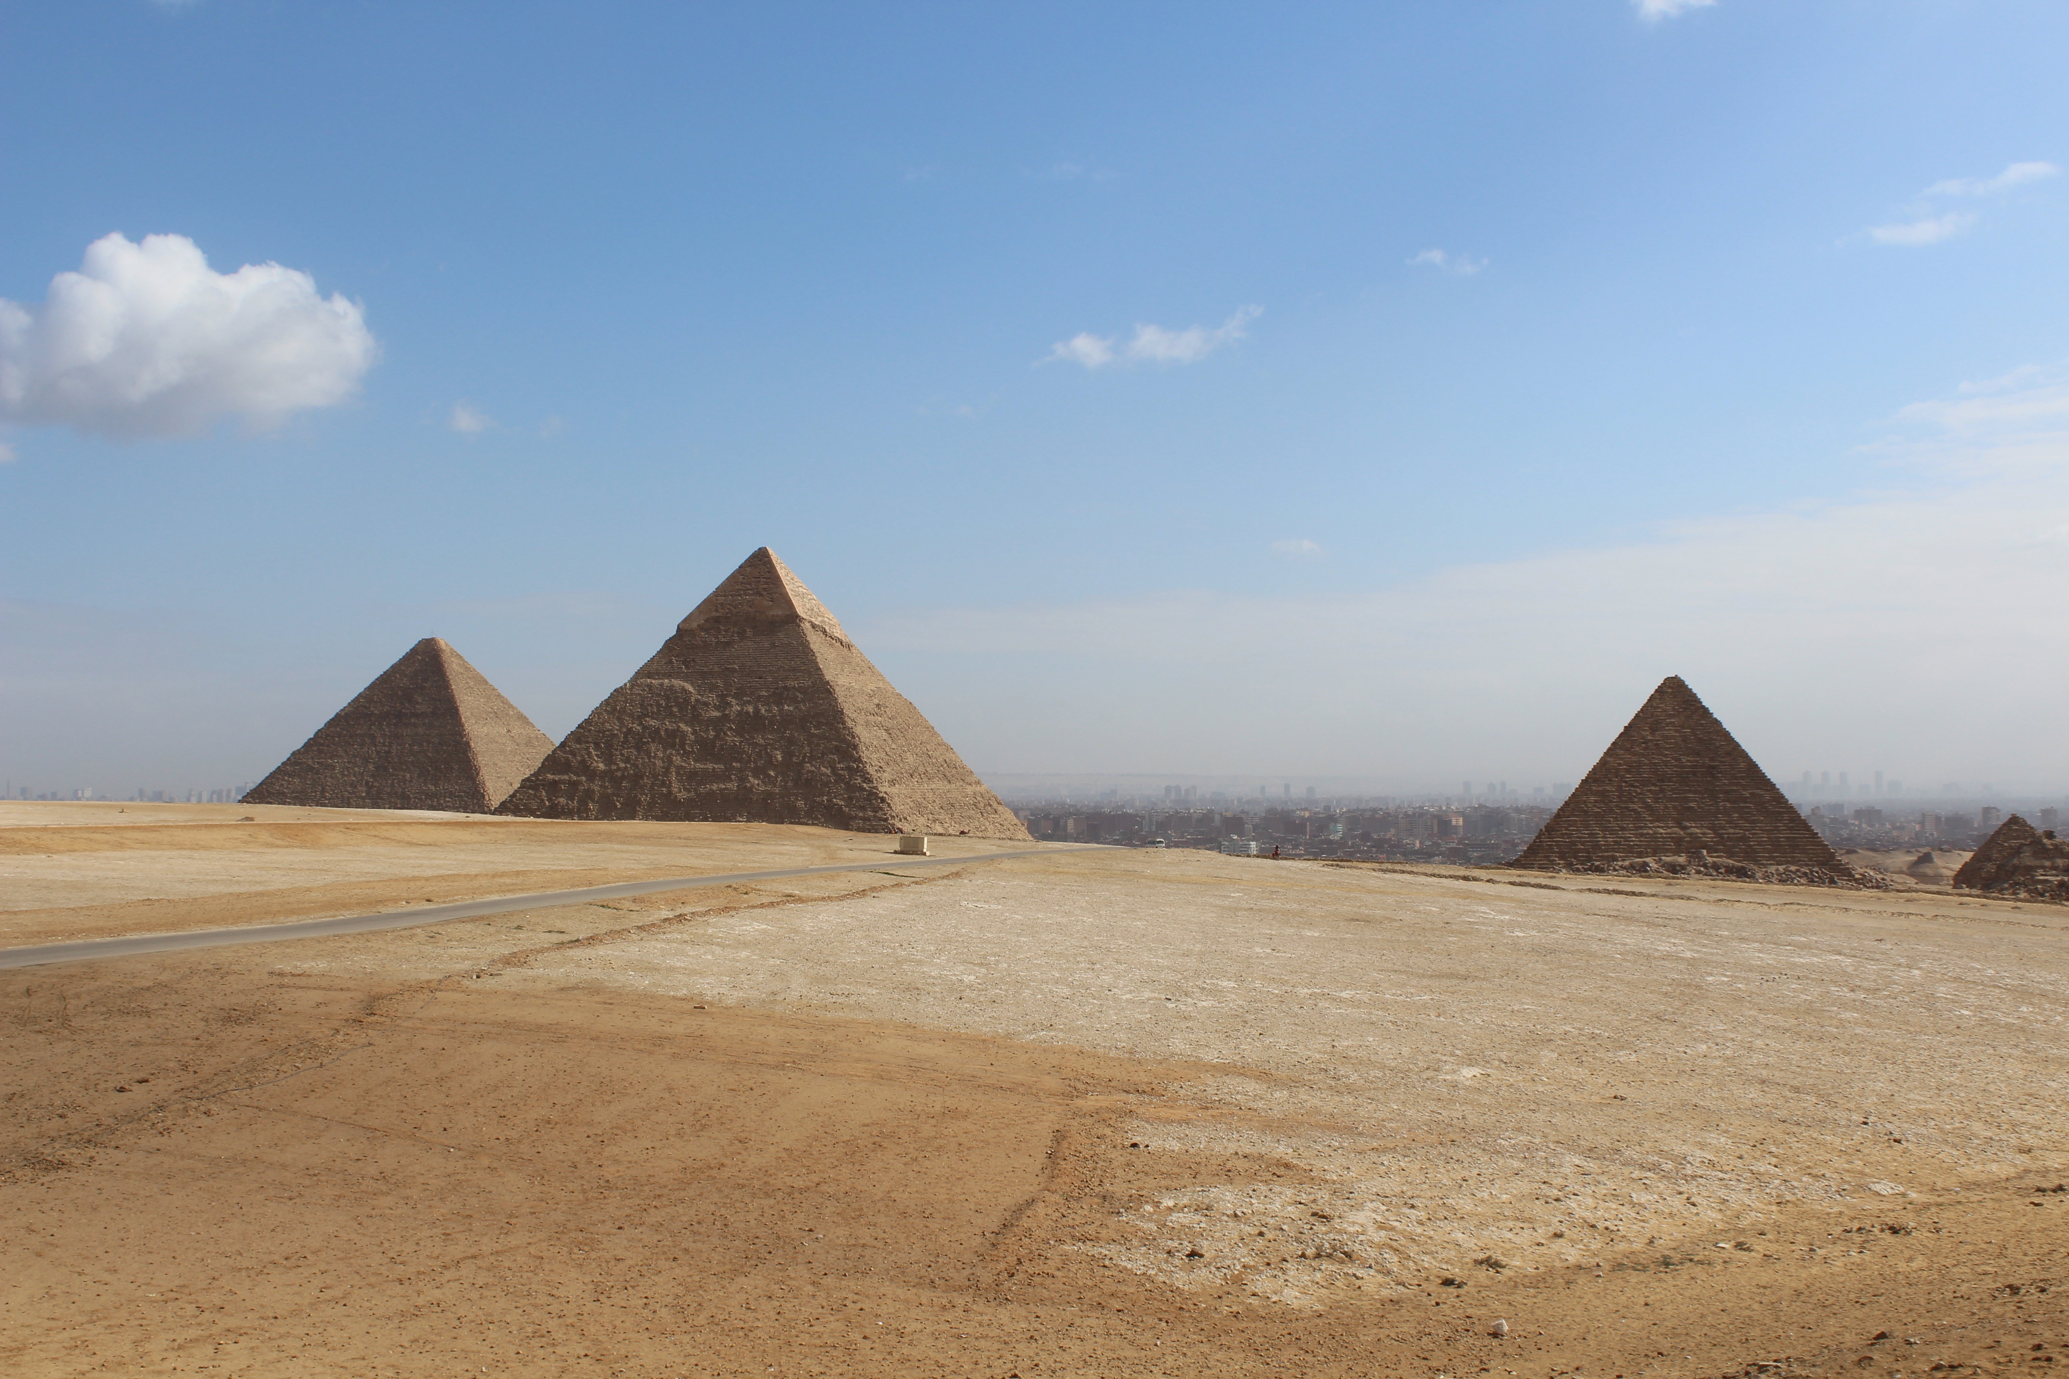
Egypt is a large country, but a large portion of it is desert. Most people (95% of Egypt's total people) live in areas around the coast of the Mediterranean Sea and along the Nile River. This includes the cities of Cairo, Alexandria, Aswan, and Port Said. Not many people live in the desert.

Slide 6
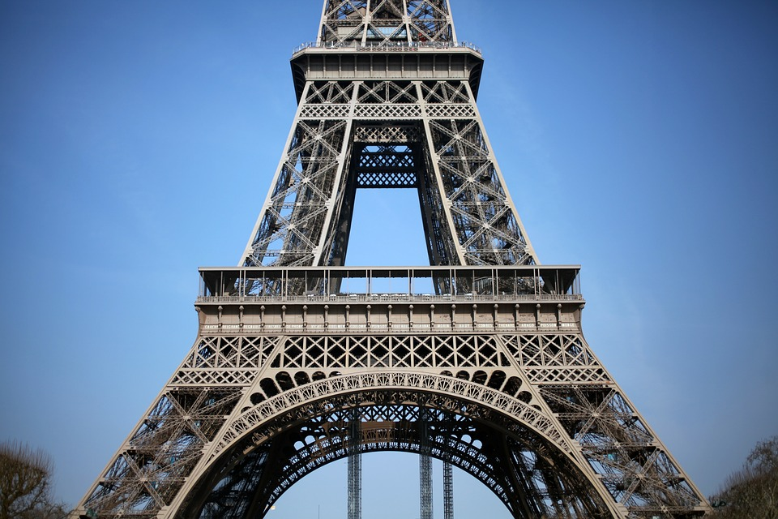
France is one of the oldest nations on Earth and the most ethnically diverse country in Europe. These deep and broad influences have made France a world leader throughout history in nearly all aspects of culture, including cuisine, wine-making, politics, philosophy, music, art, film, fashion, literature, and sports.

Slide 7
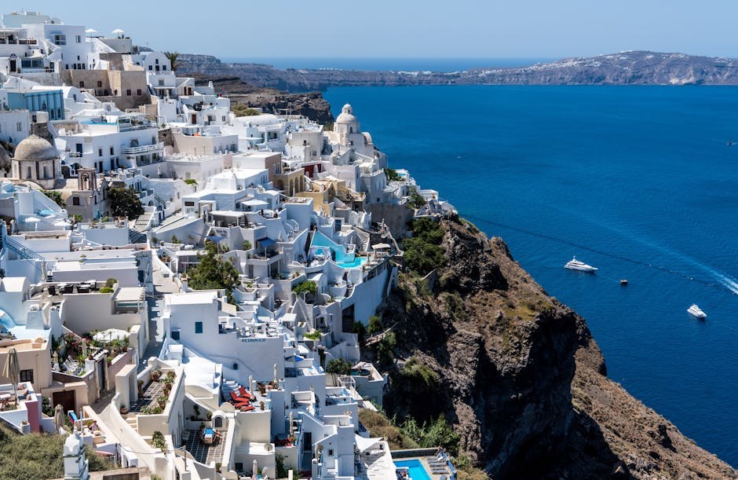
Greece has the longest coastline in Europe and is the southernmost country in Europe. The mainland has rugged mountains, forests, and lakes, but the country is well known for the thousands of islands dotting the blue Aegean Sea to the east, the Mediterranean Sea to the south, and the Ionian Sea to the west.

Slide 8
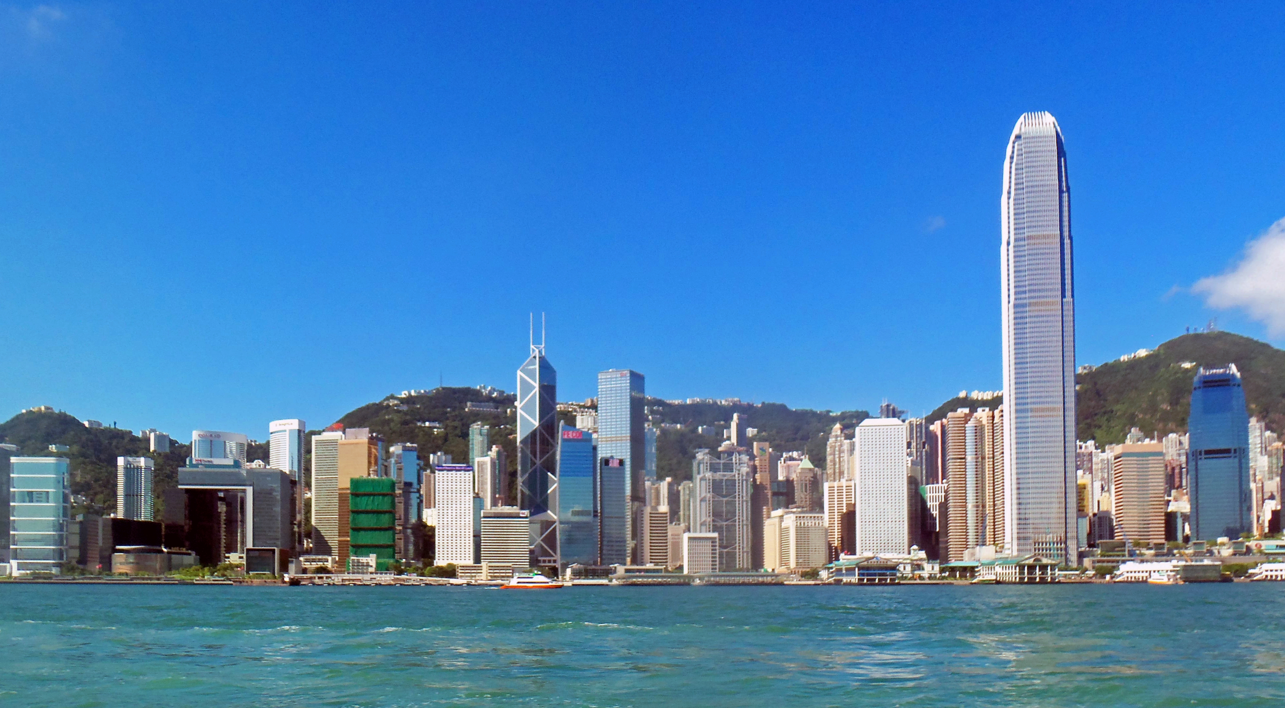
Hong Kong, Chinese Xianggang or Hsiang-kang, Special administrative region of China. Area: 430 sq mi (1,114 sq km). Population: (2024 est.) 7,541,000. Located on China’s southern coast, it consists of the island of Hong Kong and adjacent islets in the South China Sea (ceded by China to the British in 1842), the Kowloon Peninsula (ceded in 1860), and the New Territories (leased by the British from China from 1898 to 1997).

Slide 9
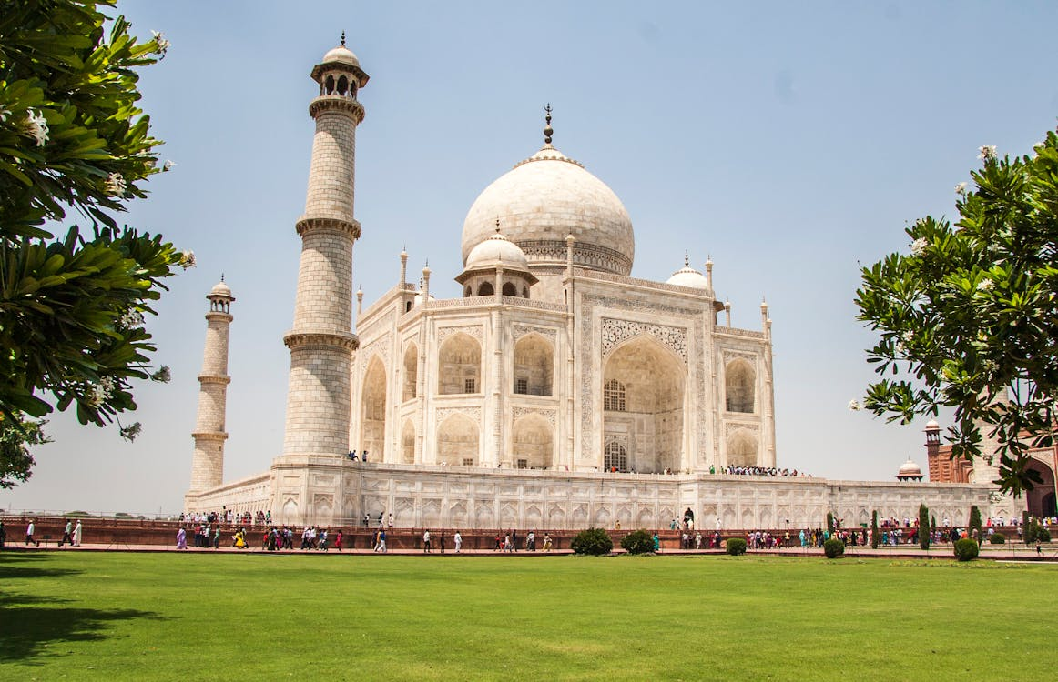
It is located in the center of South Asia. In world, Republic of India is the seventh largest country by area and the second most populated country after China. India takes honour in being the largest democracy in the world. India is a diverse country with diverse cultures, languages, climates and geography.

Slide 10
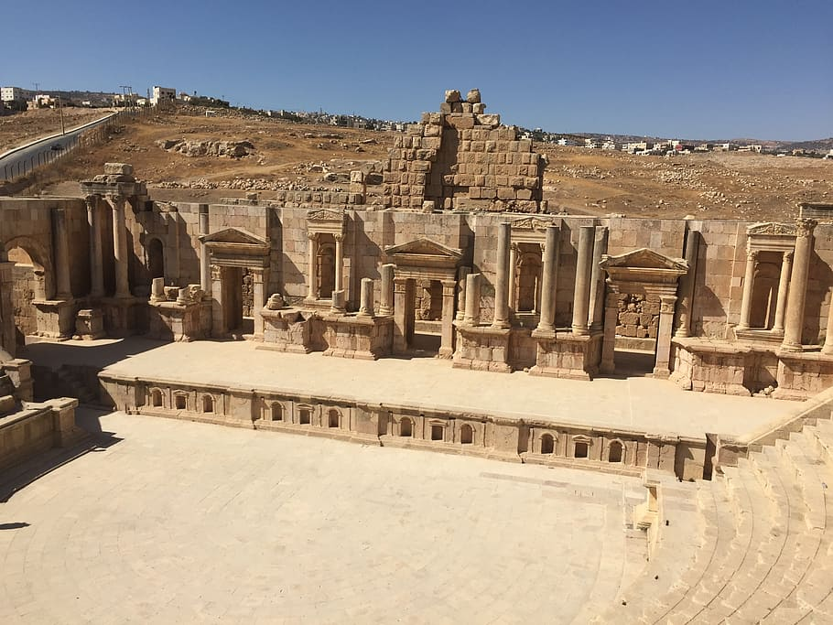
Jordan is a constitutional monarchy with two legislative houses; the head of state and government is the king, assisted by the prime minister. Jordan shares much of its history with Israel, since both occupy parts of the area known historically as Palestine.

Slide 11
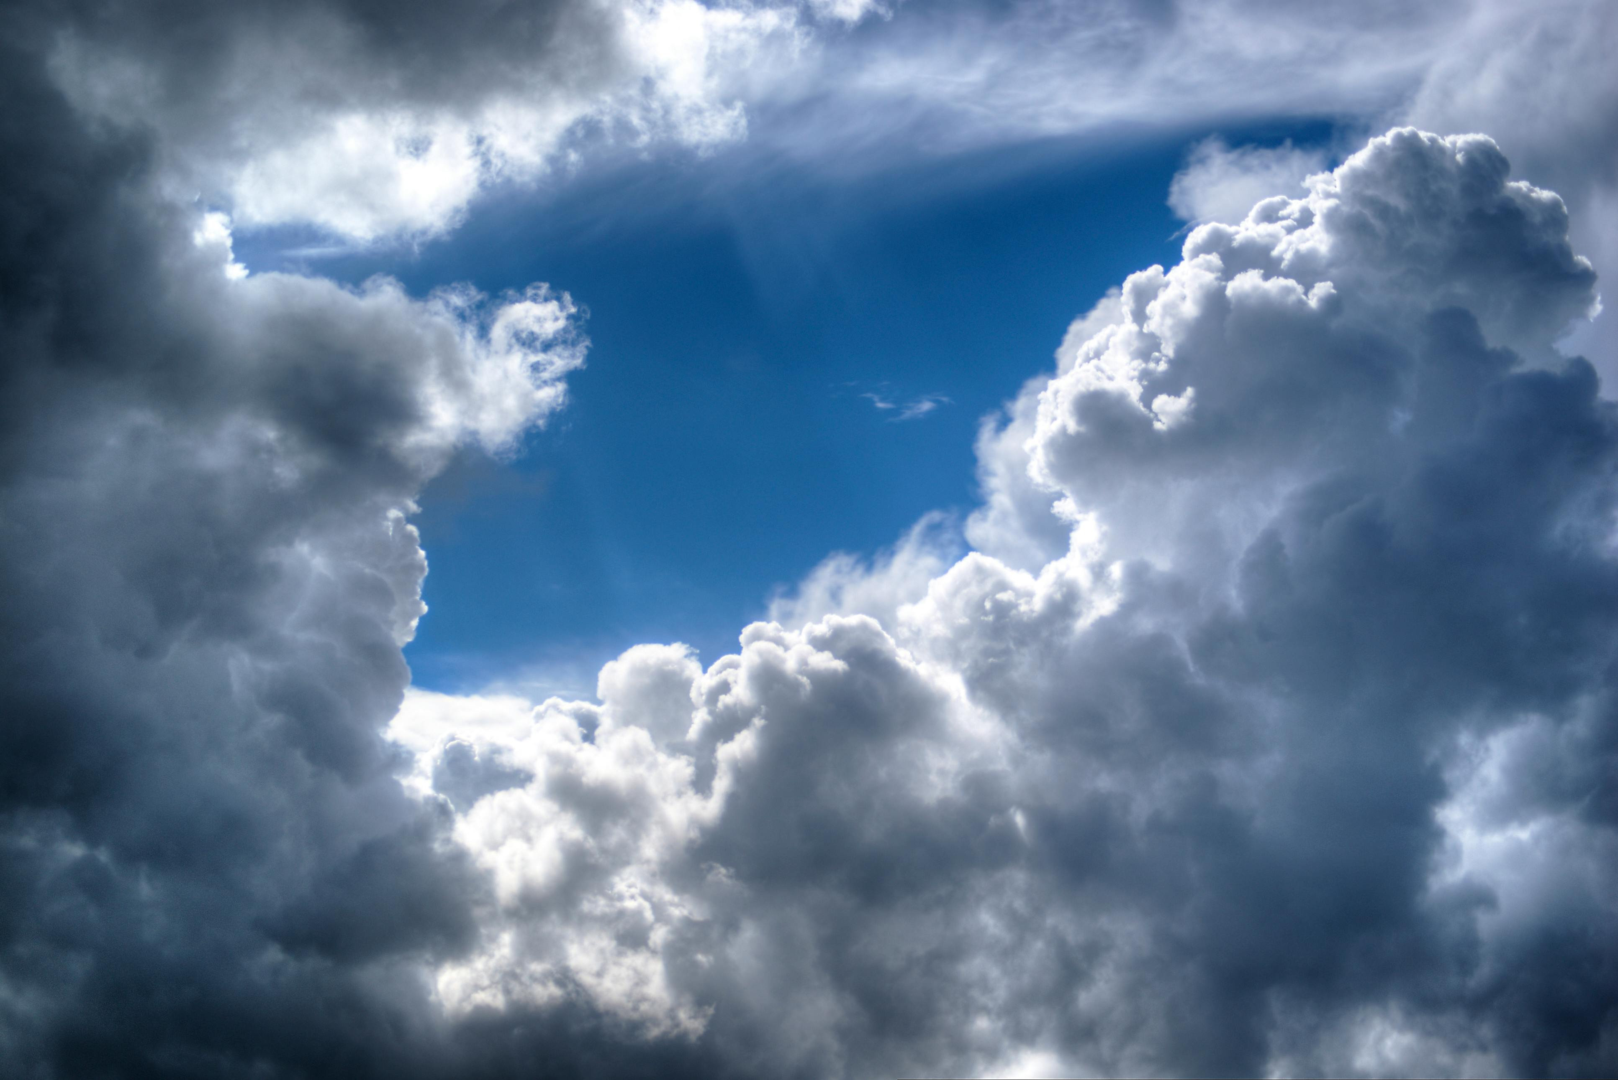
THANK YOU

